Slide 1
Software Project Management
Fitness and yoga online System
04/12/2016
Team 3:
Thai Thi Hong Minh
Le Thi Thuy Dung
Le Dinh Nhat Khanh
Nguyen Tung Duong
1
Notes:
1

Slide 2
Thai Thi Hong Minh 100%
Le Dinh Nhat Khanh 100%
Le Thi Thuy Dung 100%
Nguyen Tung Duong 80%

Slide 3
Software Project Management
Fitness and yoga online System
Content:
1. Background
Vision and statement
Start day _ end day
Budget
2.Requirement phase
Actor list
Use Cases List
Use Cases Diagram
Context Diagram
04/12/2016
3

Slide 4
Fitness and yoga online System
Software Project Management
3.WBS
WBS System
WBS product
4.Plan
Delphi
Detail plan
5.EVM
BCWS
BCWP
ACWP
CPI, SPI
04/12/2016
4

Slide 5
1. Background
Vision statement
For people who want a training system which is convenient and employees who want work easily and conveniently then Fitness and Yoga Online System (FaYOS) is a great system. Unlike other offline systems, FaYOS is an online system that helps create favorable conditions for the management of time and personnel. Customers can manage the schedule, get the latest news from the Centre and pay with just a few steps in everywhere that have Internet. Staff and coaches will also do things more conveniently because everything now is stored automatically, helping mourning work efficiency.
04/12/2016
5

Slide 6
1. Background
Start day _ End day and Budget
04/12/2016
Start day | 2/11/2016
End day | 10/4/2017
Budget | $62.000
6

Slide 7
2. Requirement phase
Actors List
Actor | Rules, Responsibility | Priority
Manager | Manage the system | 1
Staff | Manage trainers, trainees, courses, schedule, provide supports,... | 2
Trainer | Register courses, recievie notifications, calendar,... | 3
Trainee | Register for courses, pay the fees,maintaince the schedule | 3
04/12/2016
7

Slide 8
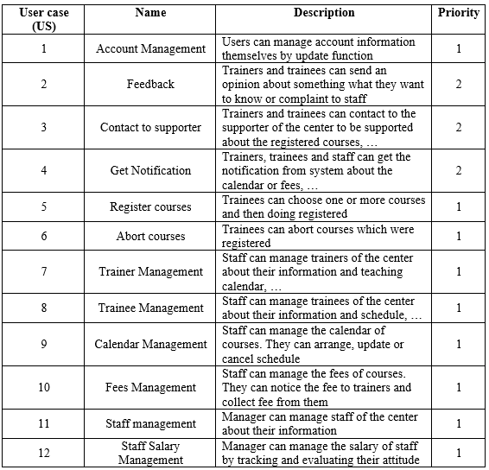
2. Requirement phase
Use Cases List
04/12/2016
8

Slide 9
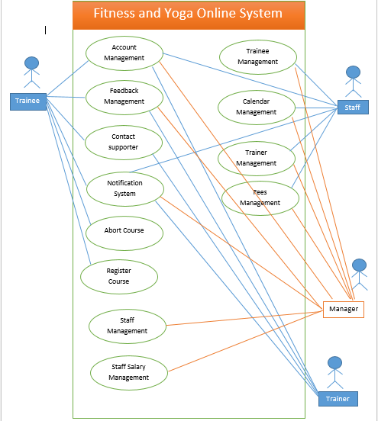
2. Requirement phase
Use Cases Diagram
04/12/2016
9

Slide 10
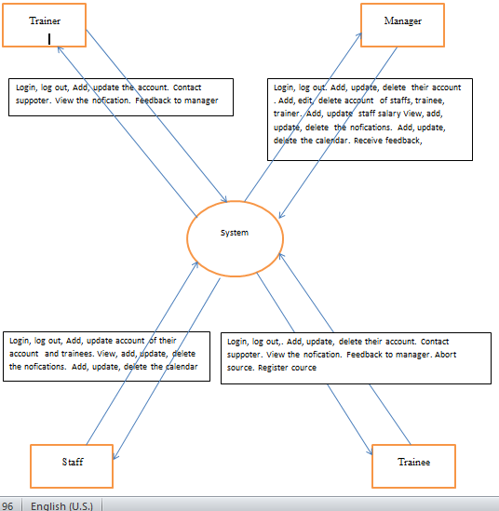
2. Requirement phase
Context Diagram
04/12/2016
10

Slide 11
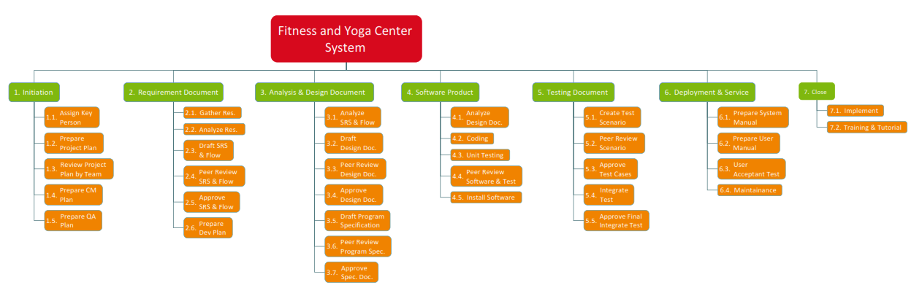
3. WBS
WBS (System)
04/12/2016
11

Slide 12
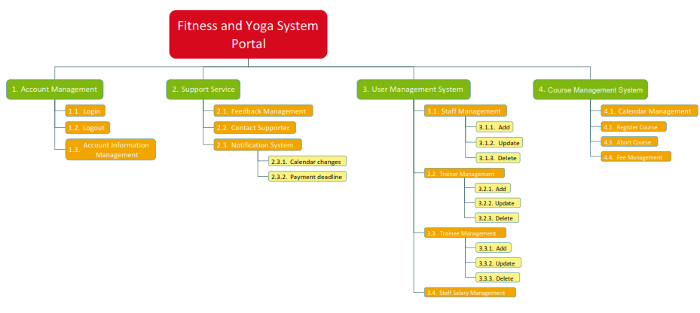
3. WBS
WBS (Product)
04/12/2016
12

Slide 13
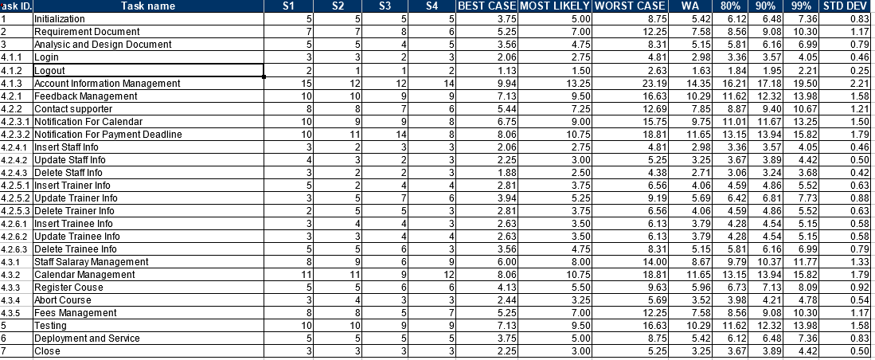
4. Plan
Delphi
04/12/2016
13

Slide 14
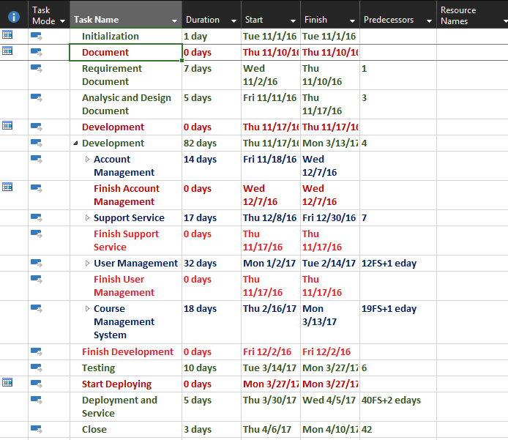
4. Plan
Detail Plan
04/12/2016
14

Slide 15
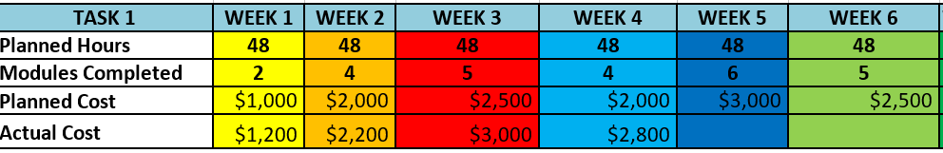
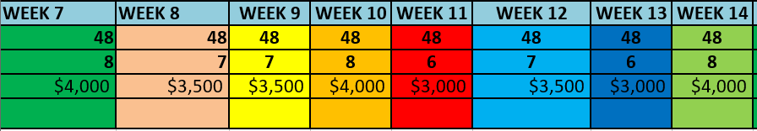
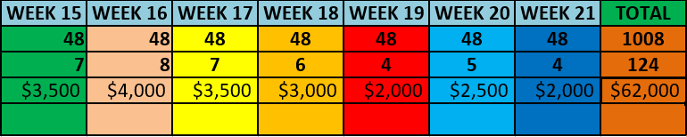
5.EVM
Plan Cost
04/12/2016
15

Slide 16
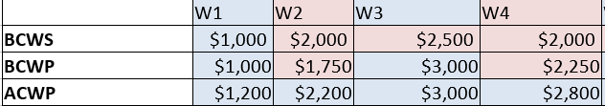
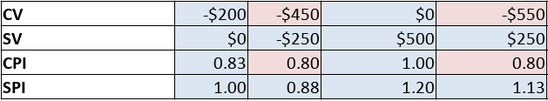
5.EVM
BCWS – BCWP – ACWP - CPI - SPI
04/12/2016
16

Slide 17
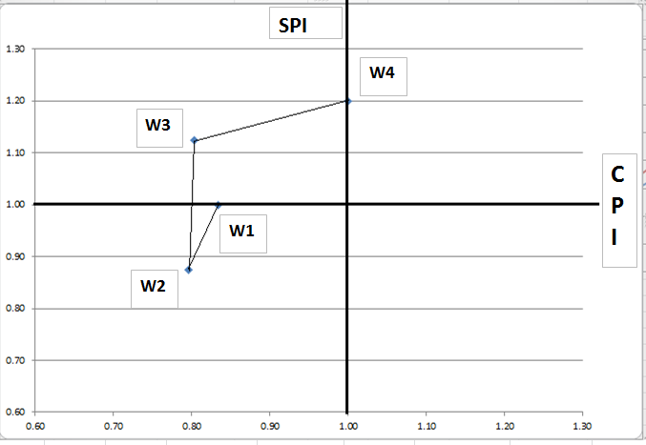
5.EVM
Plotting CPI and SPI
04/12/2016
17

Slide 18
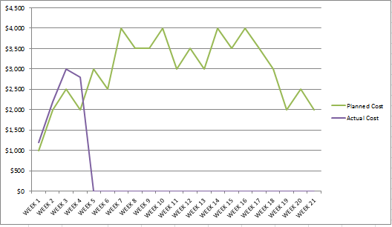
5.EVM
Forecast
04/12/2016
18

Slide 19
04/12/2016
Thank you for listening!
19

